Slide 1
Student Org Training
Fall 2024

Slide 2
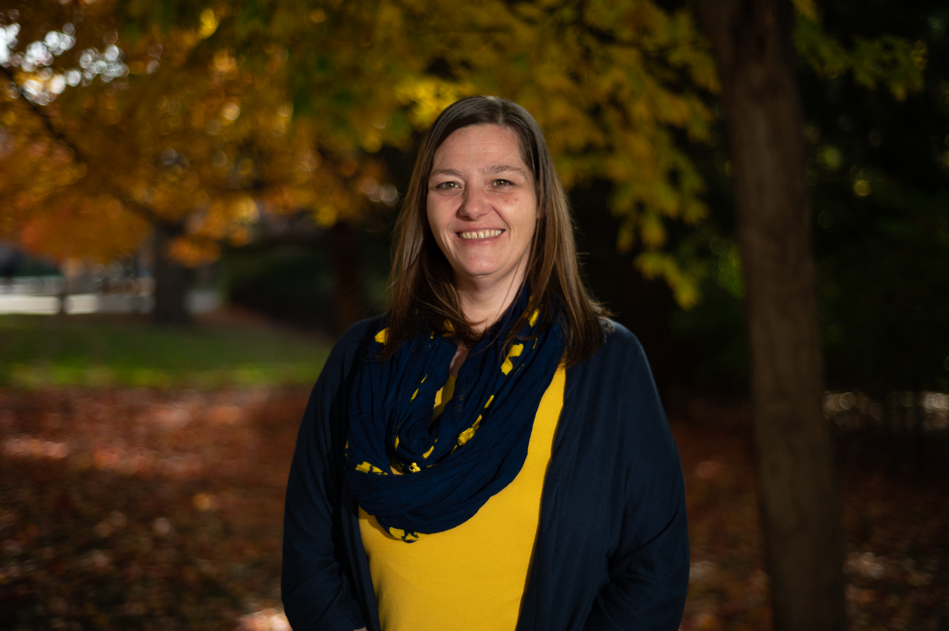
Welcome
Beth Feldkamp, LLMSW
Assistant Director of Student Services
bafeld@umich.edu

Slide 3
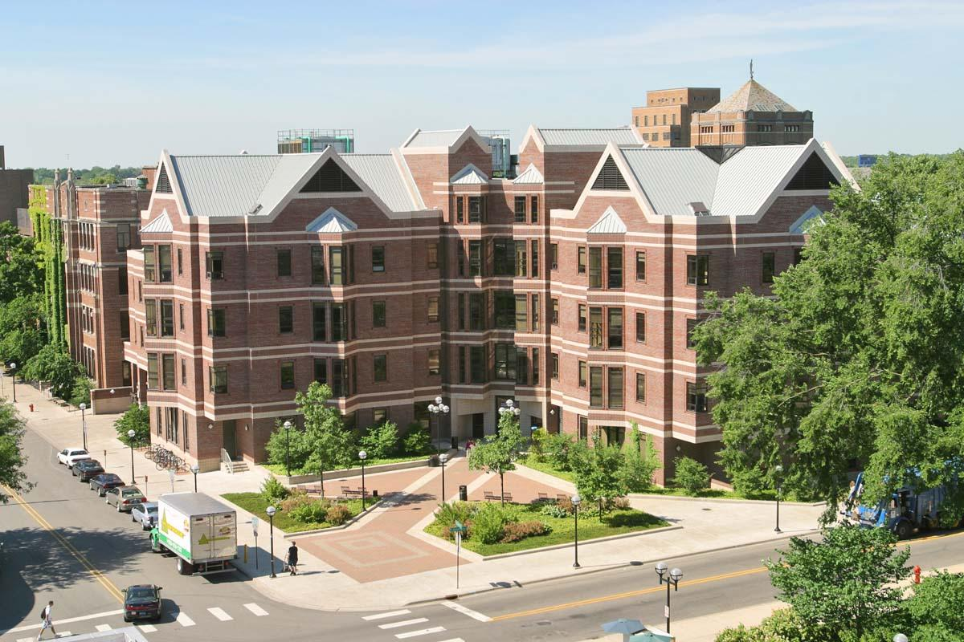
ASK US QUESTIONS
Feel free to ask questions during the session
Simply type your question into the “question box”
Type “private” if you would like an individual response
Session recording will be sent to all registrants.

Slide 4
Training Agenda
Types of Student Organizations
Student Organization Policies
Registration requirements for Student Organizations
CCI
SSW
Additional Information
Questions

Slide 5
Types of Student Orgs

Slide 6
Types of Student Organizations
Sponsored Student Organizations (SSO's)
Voluntary Student Organizations (VSO's)
Non-Affiliated Student Organizations (NSO)

Slide 7
Sponsored Student Organizations (SSO's)
Sponsored student organizations are student organizations that have a substantial relationship with a sponsoring University unit.
SSOs must be sponsored by an executive officer, dean, or director of an academic or operational unit and must have a mission that is consistent with the missions of the University and sponsoring unit.
The unit must provide an advisor for the SSO.
This designated advisor must go through training provided by CCI.
SSOs agree to be held to the same standards of responsibility as both VSOs and University Units.
Notes:
Only grop with this status is Student Government- The rest will be VSO

Slide 8
Voluntary Student Organizations (VSO's)
Voluntary student organizations are student organizations that seek access to certain University-controlled benefits and resources and are accountable to the university for legal compliance, fiscal responsibility and adherence to established community standards.
VSOs are strongly encouraged to seek out a faculty/staff advisor although an advisor is not required for VSOs.

Slide 9
Non-Affiliated Student Organizations (NSO)
Non-Affiliated Student Organizations (NSO) Non-Affiliated status only gives an organization a listing in Maize Pages. An NSO is not afforded other benefits such as a SOAS account, free space usage, University funding, or participation in student organization fairs.

Slide 10
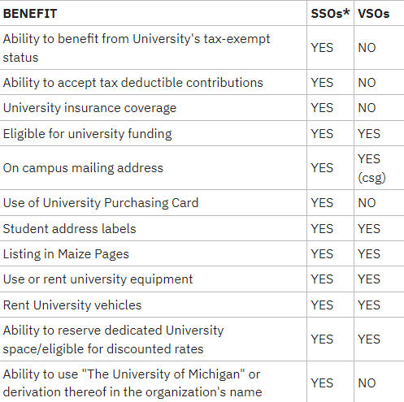

Slide 11
Student Org
Policies

Slide 12
Policies Highlights
Please look over the entire list of Policies
10 Member Policy
All student organizations must have a current Maize Pages roster that includes 10 active members.
Nondiscrimination Policy
The University of Michigan, as an equal opportunity/affirmative action employer, complies with all applicable federal and state laws regarding nondiscrimination and affirmative action.
No Hazing Policy
The University of Michigan condemns hazing practices associated with membership, advancement, leadership or continued good standing in student organizations.
Alcohol and Other Drugs Policy
SSOs, by virtue of having all funds in University accounts, cannot purchase alcohol for any event. However, an SSO may conduct an event where alcohol is served if the event complies with the venue’s alcohol policy. Alcohol may be either donated or purchased by individuals, either in bulk or through a cash bar, but may never be served in violation of local, state, or federal law.

Slide 13
Naming
No organization may adopt a name which may be construed by the University community as misleading as to the nature of affiliation of the organization. This includes acronyms.
VSOs may not use “University of Michigan,” UM, U-M, U of M, UMICH, or any other trademarked phrase at the beginning of their name, but are permitted to say Blank Club at the University of Michigan. Other trademarks, like Go Blue, cannot be used. This policy includes all online platforms (social media, email, websites, etc.)
Organizations cannot use other trademarked names.
Organization names must be unique and distinguishable from existing student organizations.
The naming policy also applies to all social media, emails, blogs, twitter & facebook accounts, handles, URLs, etc.

Slide 14
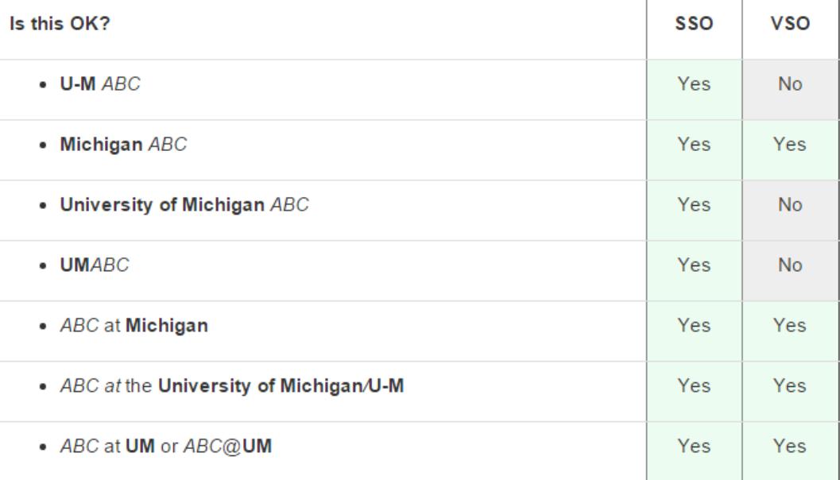

Slide 15
Logos
When creating your logo organizations also have various rules and regulations around the use of University trademarks.
VSOs and SSOs both have a relationship to the University, and each organization type has its own guidelines for proper brand usage.

Slide 16
Student Org Registration- A TWO STEP PROCESS

Slide 17
Registration Overview:
Center for Campus Involvement

Slide 18
All Organizations
Items all student organizations will need to register:
Names and emails of entire membership roster.
Rosters must have a minimum of 10 currently enrolled UM Students and majority (51%) membership being UM students
An organization profile picture
E-mail of a primary contact

Slide 19
New Organizations
Look to make sure your organization doesn't already exist on Maize Pages. Currently UofM has 1,600 organizations and there may already be just the club you're thinking of.
Think of an Organization Name and description.
Read through the Basic Requirements to be an active club.
Register for New Organization Orientation
Attending the orientation is required before you are able to submit a registration for a New Organization.

Slide 20
Existing Organizations
Go to your organization’s Maize Pages site and click the blue REGISTER button
Select 3 Authorized Signers
Authorized Signers complete:
Organization Essentials
Signer Registration
Once all 3 individuals have completed this process your organization will be a Recognized Student Organization for the year. This process at minimum two weeks from start to finish.
Note: Your organization is not considered registered this process is completed.

Slide 21
Existing Frozen Organizations
For organizations that are currently frozen, they are able to re-register while being frozen.
Please complete the following steps:
Click on your personal profile in the top right corner
Select the "Memberships" tab
Go to organization's site
Select the "Register" button on the organization's site and follow the directions, making sure to include the required items (listed above) for a successful re-registration
Notes:
However, the steps to get to your organization page is a bit different.

Slide 22
Student Organization registration opens annually on March 1st to September 30th (Next Monday!).
If you do not re-register during that period your organization will be frozen until registration is completed.

Slide 23
Registration Overview:
SSW- Office of Student Services

Slide 24
SSW Registration
Registration with OSS: Required during fall and winter semesters.
Annual Registration with CCI: Recommended in the fall.
Documents Needed:
School of Social Work registration form
Google form
Group constitution
List of members
Compliance: Adhere to CCI’s Standards of Conduct and University of Michigan Non Discrimination Policy.
For more details, visit the Center for Campus Involvement website.

Slide 25
Additional Information

Slide 26
Student organizations will receive a $50 grant when they register with OSS.
Small ($300 max) or Large Grants ($1,500 max)
Room Reservations
Office Space- Room 1630
Student organizations that have VSO or SSO status may raise funds.
Any selling of merchandise by a student organization must first be approved by the SSWSG.
The University has restrictions on the sale of food.
Check with the Office of Student Services and Enrollment Management before planning to raise funds by selling food.

Slide 27
Maize Pages

Slide 28
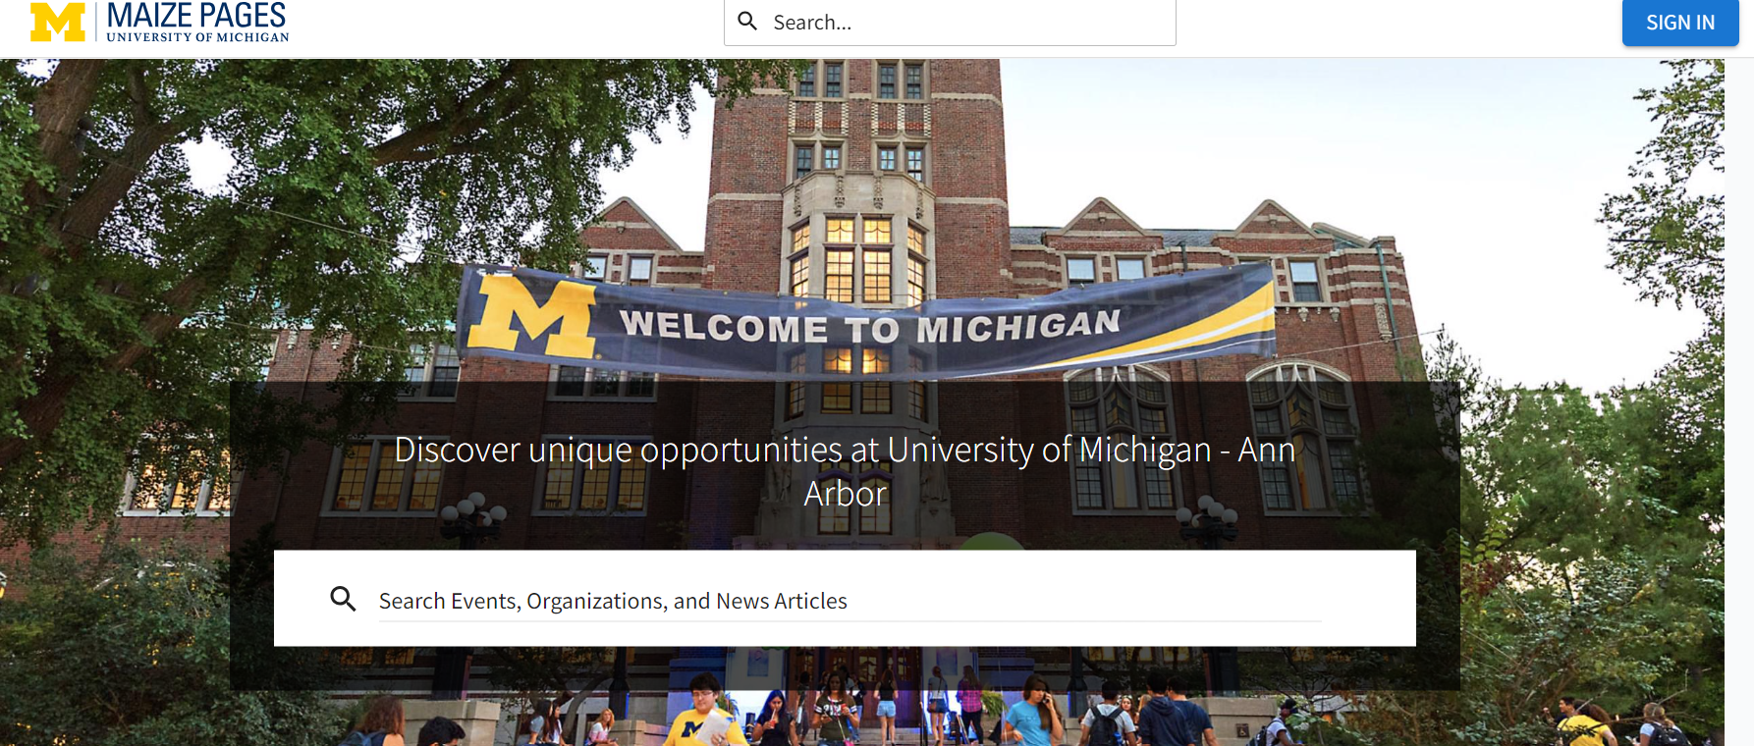

Slide 29
Maize Pages
Maize Pages is a website run through the University of Michigan in collaboration with Campus Labs that is designed to help student organization leaders to manage their group.
This includes resources for managing your roster, saving and storing documents, and more for leaders of the organization

Slide 30
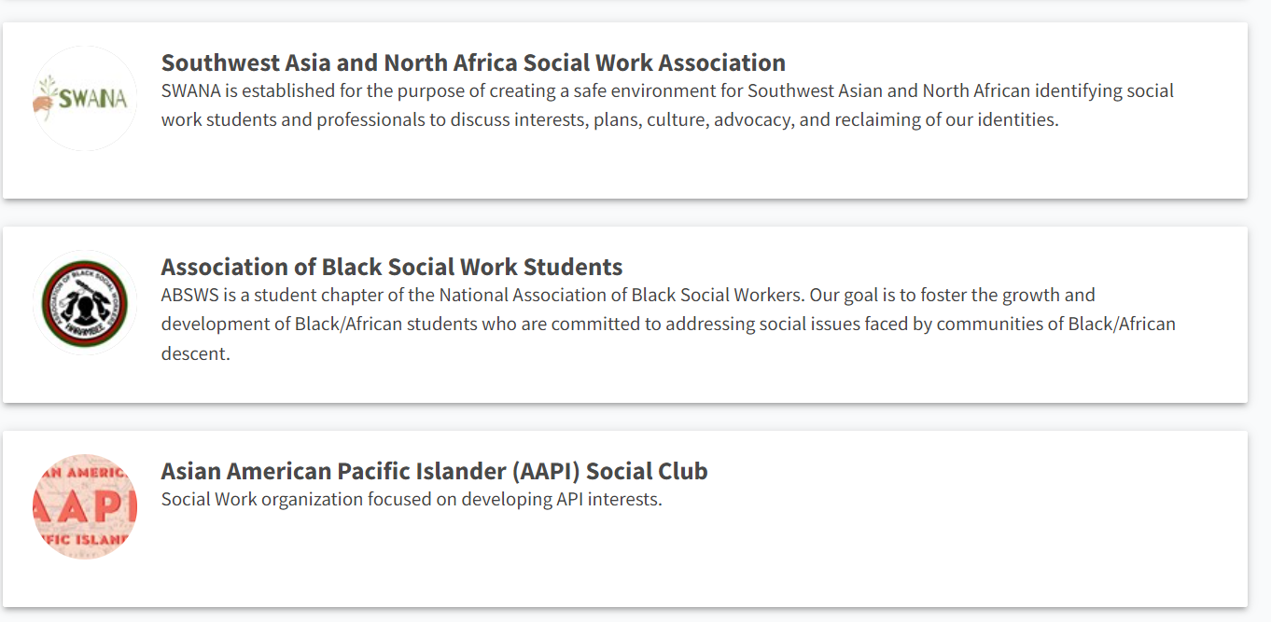
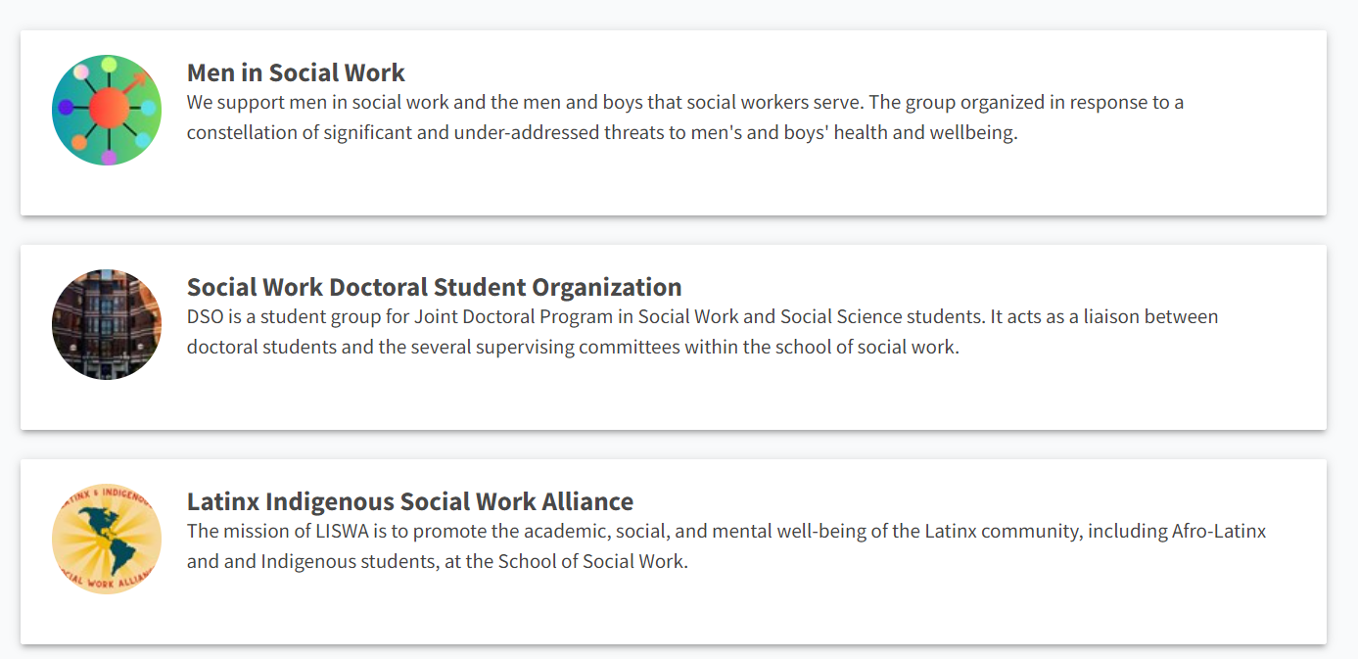

Slide 31
Any Questions?
Questions?
Office of Student Services & Enrollment Management
(734) 936-0961
ssw.msw.info@umich.edu
U-M School of Social Work
1080 South University Ave. Room 1748
Ann Arbor, MI 48109-1106
https://ssw.umich.edu/
9-4pm (EST)

