Slide 1
Since 1886, the Children's Hospital of Michigan has been dedicated to providing the highest quality of care to children and adolescents in a caring, efficient and family-centered environment. A proud member of the Detroit Medical Center (DMC), the Children's Hospital of Michigan was the first children's hospital in the state. This 228-bed facility has an international reputation in pediatric medicine, surgery and research, training more pediatricians than any other facility in Michigan. The Children’s Hospital of Michigan engages in groundbreaking research that has long shaped the science of pediatric medicine.
The Social Work Internship Program at the Children’s Hospital of Michigan offers an immersive, structured experience for advanced MSW students. Interns commit to 24 hours per week across three days, reflecting the fast-paced hospital environment.
The program features a multi-layered learning model, including a primary assignment to build core clinical skills and a secondary experience that provides exposure to diverse settings such as emergency care, inpatient and outpatient services, and community-based work. This approach helps students connect theory to practice while developing adaptability and resilience.
A competitive placement process ensures strong alignment between interns and field instructors. Ongoing support is provided through monthly Social Work Intern Meetings, offering education, case discussion, and peer connection. Overall, the program prepares students for medical social work through hands-on experience, mentorship, and professional development.
For more information check out the main website

Slide 2


Stu_{Vo}d_{ic}e_{e}n_{s}ts’
“Originally, I wanted nothing to do with an internship in Detroit. It was far away, a place I didn’t see myself working at, and honestly, I worried about the traffic. However, even a week into my internship at Children’s Hospital of Michigan, I was glad I made the decision to go there. I felt part of a team immediately, I was greeted and welcomed with so much knowledge and joy.
The staff there really know what they are doing and enjoy doing it. This internship not only strengthened my desire to be a social worker, it made me forget I was paying to be there. I was part of the General Pediatric Clinic but got to shadow many different clinics. This gave a broad spectrum of what hospital social work is like because I wasn’t just locked to one location. They do classes and work with you not just talk at you. I felt part of the family, and I so needed that feeling through my graduate program. I learned how to talk to people, feel confident in myself, and how to work with a community I wasn’t part of. Every time I had a question, people were there to answer graciously, and I never felt looked down on. They were encouraging and I felt support and confidence every day, even the days I felt like I didn’t know what I was doing. Interning at Children’s Hospital of Michigan was probably my favorite part of graduate school. It was where I grew, where I learned, and frankly where I found myself. I recommend this internship if you want to work with knowledgeable and outstanding social workers who take pride in teaching others. You are not just an intern here, but part of the family. I will always remember the people at Children’s Hospital and am thankful for all the information they imparted on me. It was worth the drive, worth the chaos (because there will be some there) and came out stronger for it. You will learn multiple different aspects of social work and feel like part of the community. If you want to learn about hospital social work, you will find a home here where you can expand your knowledge and be part of a team”

Slide 3


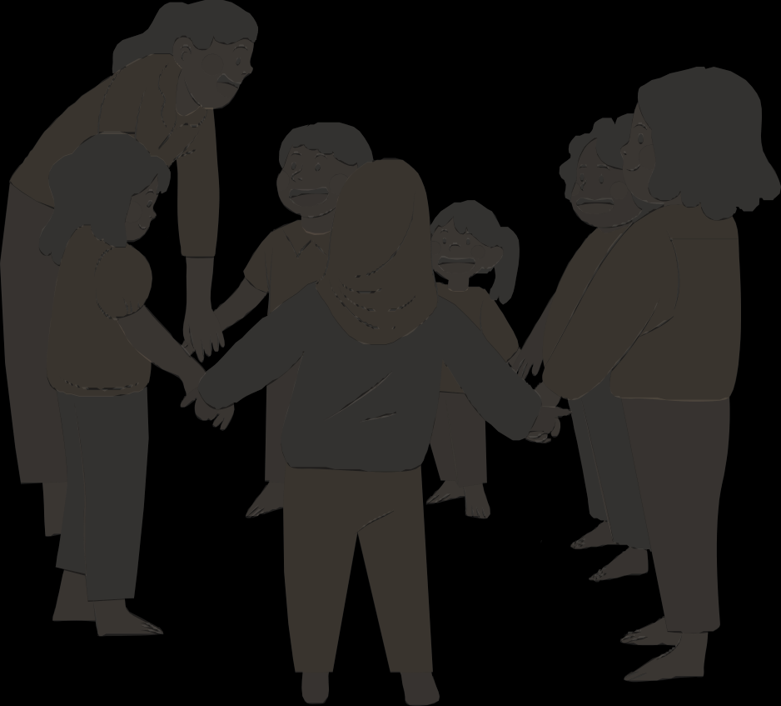
Stu_{Vo}d_{ic}e_{e}n_{s}ts’
“My internship at Children’s Hospital was easily the most enriching part of my graduate experience. I got to do so much hands-on work every day with a huge range of cases. There was never a dull day, and it was incredible to see how much I could grow in only one year. I also had incredible support from my supervisor, who was an extremely talented social worker and so dedicated to my education. The atmosphere was so fun and so supportive, definitely the ideal place to learn and grow.
Now, as I’ve been in the field for a few years, I constantly think back to what I learned at Children’s and am so grateful I got to build my foundation there.”
“Interns at GPAM get to spend a lot of time directly with patients and their families assessing their unique needs and providing resources.
This helps you learn more about behavioral health and developmental needs. Additionally, you get to work with and learn from an interdisciplinary team including psychologists, other social workers, physicians, and MAs. The social workers give great feedback on notes, assessments, and resources along the way. I felt ready to go out on my own after all the experience at Children’s Hospital of Michigan.
Another bonus was the opportunity to take on a therapy case and shadow social workers in unique settings (i.e. transplant, emergency department, and school based social work). There are great social workers throughout Children’s Hospital of Michigan.”

Slide 4


Stu_{Vo}d_{ic}e_{e}n_{s}ts’
“My internship at Children’s Hospital was easily the most enriching part of my graduate experience. I got to do so much hands-on work every day with a huge range of cases. There was never a dull day, and it was incredible to see how much I could grow in only one year. I also had incredible support from my supervisor, who was an extremely talented social worker and so dedicated to my education. The atmosphere was so fun and so supportive, definitely the ideal place to learn and grow. Now, as I’ve been in the field for a few years, I constantly think back to what I learned at Children’s and am so grateful I got My pathway was Welfare of Children and Families and I was also part of the Child Welfare Scholarship Program which required specific internship criteria. I spent 12 months at Children’s Hospital of Michigan (CHM) in Detroit completing my internship. Most of my time was spent in the Emergency Room, but I also cross trained in the Trauma and Burn Department. These experiences absolutely prepared me to enter the field of social work upon completion of my MSW. CHM has an international reputation in pediatric medicine, surgery and research, and training. When selecting an internship, I wanted to ensure that I received a well-rounded learning experience. I firmly believe that between the patients that we serve and the wide variety of specialties offered, I was able to smoothly transition into the job field. I was often able to make direct connections between what I was learning in class and what I was doing in field.
One thing about learning in Detroit is the amount of patients who are transferred here from numerous outside area hospitals. Because of this, I was able to be involved in an assortment of unique cases and social situations.
Metro Detroit is extremely diverse and I learned so much about several cultures and social norms. CHM invests in their interns, providing them opportunities outside of their specific roles as interns. I was able to participate in several mock interviews and job shadowing as I was approaching graduation. Many of the social workers here are very seasoned and they obviously love to devote their time to the next generation of social workers. I feel very fortunate to have had the unique experience of being an intern in Detroitbuild my foundation there.”

